Slide 1
Lecture № 5
Connective Tissues

Slide 2
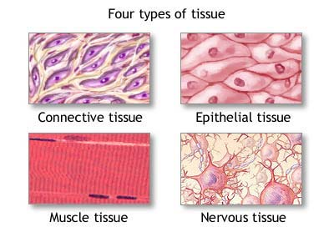
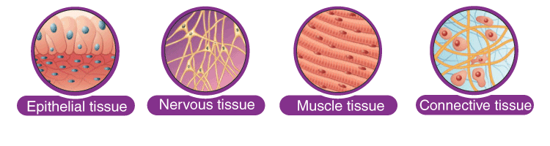
The organs in the body are composed of four basic types of tissue, including:
Epithelial.
Connective.
Muscular.
Nervous.

Slide 3
Connective tissue
Connective tissue provides a matrix that supports and physically connects other tissues and cells together to form the organs of the body. The interstitial fluid of connective tissue gives metabolic support to cells as the medium for diffusion of nutrients and waste products. Unlike the other tissue types (epithelium, muscle, and nerve), which consist mainly of cells, the major constituent of connective tissue is the extracellular matrix (ECM).
Extracellular matrices consist of different combinations of protein fibers (collagen and elastic fibers) and ground substance.
Ground substance is a complex of anionic, hydrophilic proteoglycans, glycosaminoglycans (GAGs), and multiadhesive glycoproteins (laminin, fibronectin, and others).

Slide 4
The variety of connective tissue types in the body reflects differences in composition and amount of the cells, fibers, and ground substance which together are responsible for the remarkable structural, functional, and pathologic diversity of connective tissue.

Slide 5
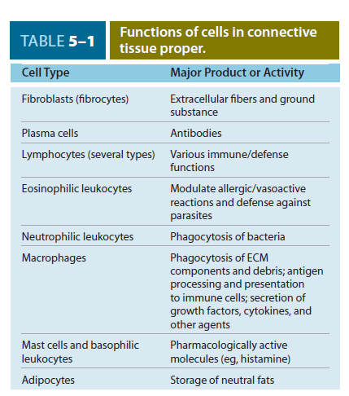

Slide 6
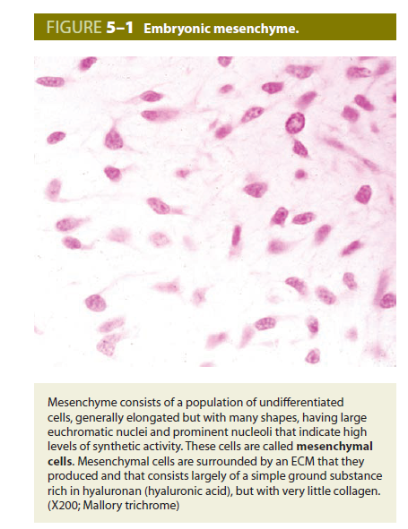
All connective tissues originate from embryonic mesenchyme, a tissue developing mainly from the middle layer of the embryo, the mesoderm. Mesenchyme consists largely of viscous ground substance with few collagen fibers.
Mesenchymal cells are undifferentiated and have large nuclei, with prominent nucleolus and fine chromatin. They are often said to be “spindle-shaped,” with their scant cytoplasm extended as two or more thin cytoplasmic processes. Mesodermal cells migrate from their site of origin in the embryo, surrounding and penetrating developing organs. In addition to producing all types of connective tissue proper and the specialized connective tissues bone and cartilage, the embryonic mesenchyme includes stem cells for other tissues such as blood, the vascular endothelium, and muscle.

Slide 7
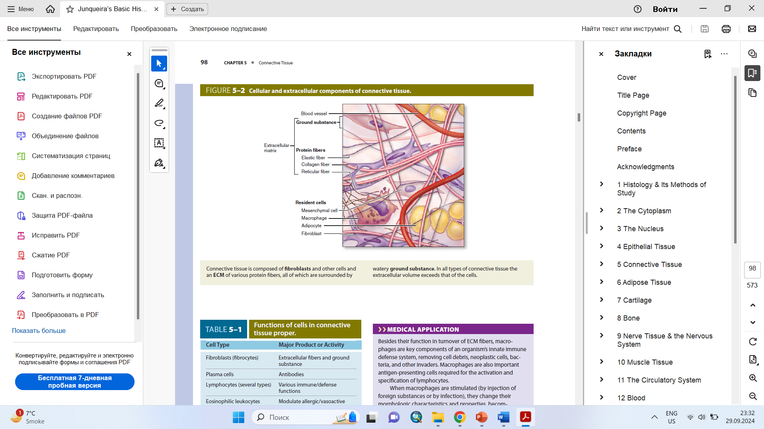
CELLS OF CONNECTIVE TISSUE
Fibroblasts are the key cells in connective tissue proper. Fibroblasts originate locally from mesenchymal cells and are permanent residents of connective tissue. Other cells found here, such as macrophages, plasma cells, and mast cells, originate from hematopoietic stem cells in bone marrow, circulate in the blood, and then move into connective tissue where they function. These and other white blood cells (leukocytes) are transient cells of most connective tissues, where they perform various functions for a short period as needed and then die by apoptosis.

Slide 8
Fibroblasts
Fibroblasts, the most common cells in connective tissue proper, produce and maintain most of the tissue’s extracellular components. Fibroblasts synthesize and secrete collagen (the most abundant protein of the body) and elastin, which both form large fibers, proteoglycans, and multiadhesive glycoproteins that comprise the ground substance.
Distinct levels of fibroblast activity can be observed histologically.
Some histologists reserve the term “fibroblast” to denote the active cell and “fibrocyte” to denote the resting cell.
The active fibroblast has more abundant and irregularly branched cytoplasm, containing much rough endoplasmic reticulum (RER) and a well-developed Golgi apparatus, with a large, ovoid, euchromatic nucleus and a prominent nucleolus. The resting cell is smaller than the active fibroblast, is usually spindle-shaped with fewer processes, much less RER, and a darker, more heterochromatic nucleus.

Slide 9
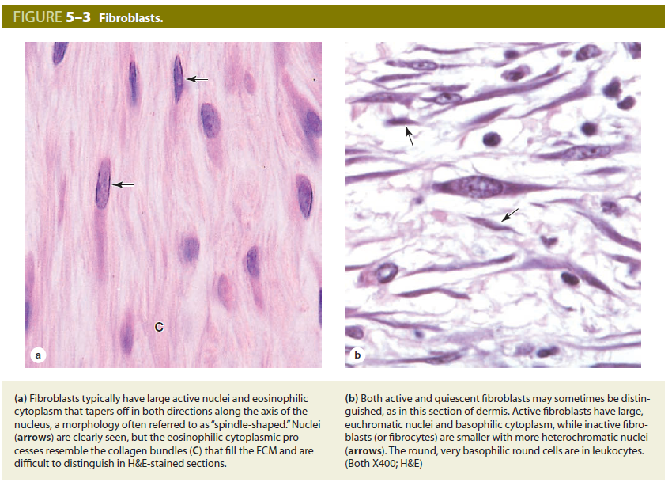

Slide 10
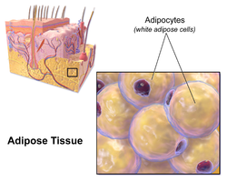
Adipocytes
Adipocytes or fat cells, are found in the connective tissue of many organs. These large, mesenchymally derived cells are specialized for cytoplasmic storage of lipid as neutral fats, or less commonly for the production of heat. Tissue with a large population of adipocytes, called adipose connective tissue, serves to cushion and insulate the skin and other organs. Adipocytes have major metabolic significance with considerable medical importance.

Slide 11
Macrophages & the Mononuclear Phagocyte System
Macrophages have highly developed phagocytic ability and specialize in turnover of protein fibers and removal of apoptotic cells, tissue debris, or other particulate material, being especially abundant at sites of inflammation. Size and shape vary considerably, corresponding to their state of functional activity. A typical macrophage measures between 10 and 30 μm in diameter and has an eccentrically located, oval or kidney-shaped nucleus. Macrophages are present in the connective tissue of most organs and are sometimes referred to by pathologists as “histiocytes.”

Slide 12
In the TEM (Transmission electron micrograph), macrophages are shown to have a characteristic irregular surface with pleats, protrusions, and indentations, features related to their active pinocytotic and phagocytic activities. They generally have well-developed Golgi complexes and many lysosomes.
Macrophages derive from monocytes circulating in the blood. During inflammation and tissue repair which follow organ damage, macrophages become activated and play a very important role. The transformation from monocytes to macrophages in connective tissue involves increases in cell size, increased protein synthesis, and increases in the number of Golgi complexes and lysosomes. In addition to debris removal, macrophages secrete growth factors important for tissue repair and also function in the uptake, processing, and presentation of antigens for lymphocyte activation

Slide 13
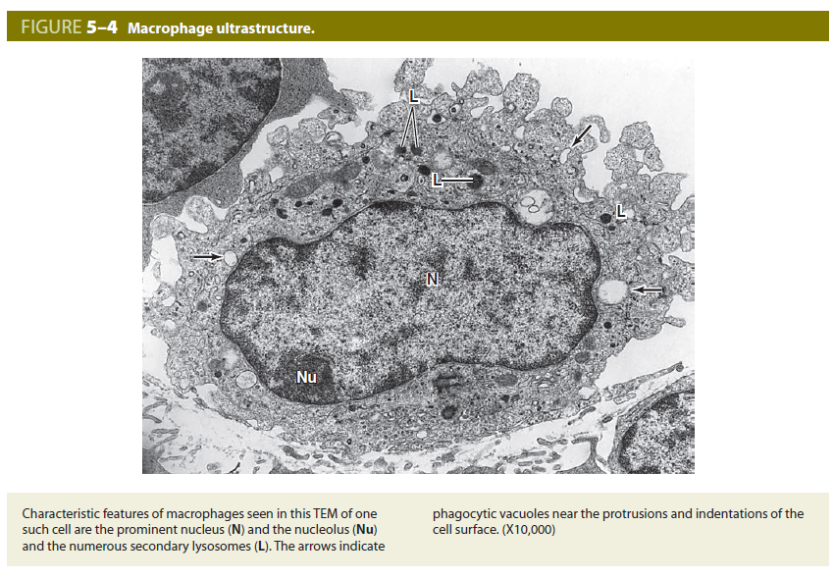

Slide 14
Mast Cells
Mast cells are oval or irregularly shaped cells of connective tissue, between 7 and 20 μm in diameter, filled with basophilic secretory granules that often obscure the central nucleus. These granules are electron dense and of variable size, ranging from 0.3 to 2.0 μm in diameter.
Mast cells function in the localized release of many bioactive substances important in the local inflammatory response, innate immunity, and tissue repair. A partial list of molecules released from these cells’ secretory granules includes the following:
Heparin, a sulfated GAG that acts locally as an anticoagulant
Histamine, which promotes increased vascular permeability and smooth muscle contraction
Serine proteases, which activate various mediators of inflammation
Eosinophil and neutrophil chemotactic factors, which attract those leukocytes
Cytokines, polypeptides directing activities of leukocytes and other cells of the immune system
Phospholipid precursors, which are converted to prostaglandins, leukotrienes, and other important lipid mediators of the inflammatory response.

Slide 15
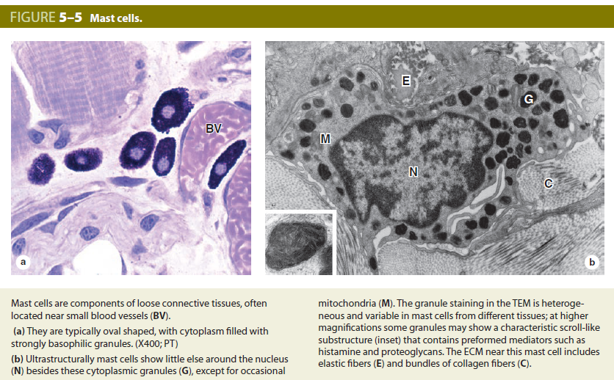

Slide 16
Occurring in connective tissue of many organs, mast cells are especially numerous near small blood vessels in skin and mesenteries (perivascular mast cells) and in the tissue that lines digestive and respiratory tracts (mucosal mast cells); the granule content of the two populations differs somewhat. These major locations suggest that mast cells place themselves strategically to function as sentinels detecting invasion by microorganisms.
Release of certain chemical mediators stored in mast cells promotes the allergic reactions known as immediate hypersensitivity reactions because they occur within a few minutes after the appearance of an antigen in an individual previously sensitized to that antigen. There are many examples of immediate hypersensitivity reaction; a dramatic one is anaphylactic shock, a potentially fatal condition.
Like macrophages, mast cells originate from progenitor cells in the bone marrow, which circulate in the blood, cross the wall of small vessels called venules, and enter connective tissues, where they differentiate. Although mast cells are in many respects similar to basophilic leukocytes, they appear to have a different lineage at least in humans.

Slide 17
Plasma Cells
Plasma cells are lymphocyte-derived, antibody-producing cells. These relatively large, ovoid cells have basophilic cytoplasm rich in RER and a large Golgi apparatus near the nucleus that may appear pale in routine histologic preparations.
The nucleus of the plasma cell is generally spherical but eccentrically placed. Many of these nuclei contain compact, peripheral regions of heterochromatin alternating with lighter areas of euchromatin. At least a few plasma cells are present in most connective tissues. Their average life span is only 10-20 days.

Slide 18
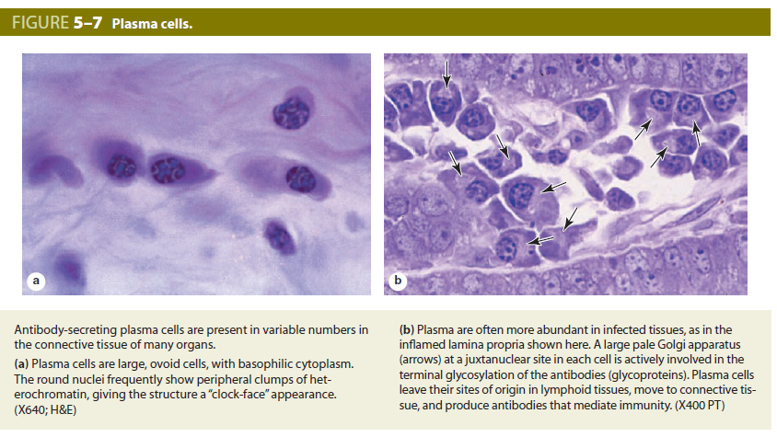

Slide 19
Leukocytes
Other white blood cells, or leukocytes, besides macrophages and plasma cells normally comprise a population of wandering cells in connective tissue. Derived from circulating blood cells, they leave blood by migrating between the endothelial cells of venules to enter connective tissue. This process increases greatly during inflammation, which is a vascular and cellular defensive response to injury or foreign substances, including pathogenic bacteria or irritating chemical substances.
Inflammation begins with the local release of chemical mediators from various cells, the ECM (extracellular matrix) and blood plasma proteins. These substances act on local blood vessels, mast cells, macrophages, and other cells to induce events characteristic of inflammation, for example, increased blood flow and vascular permeability, entry and migration of leukocytes, and activation of macrophages for phagocytosis.
Most leukocytes function in connective tissue only for a few hours or days and then undergo apoptosis.

Slide 20
FIBERS
The fibrous components of connective tissue are elongated structures formed from proteins that polymerize after secretion from fibroblasts.
The three main types of fibers include collagen, reticular, and elastic fibers.
Collagen and reticular fibers are both formed by proteins of the collagen family, and elastic fibers are composed mainly of the protein elastin. These fibers are distributed unequally among the different types of connective tissue, with the predominant fiber type conferring most specific tissue properties.

Slide 21
Collagen
Collagen is a key element of all connective tissues, as well as epithelial basement membranes and the external laminae of muscle and nerve cells.
Collagen is the most abundant protein in the human body, representing 30% of its dry weight. A major product of fibroblasts, collagens are also secreted by several other cell types and are distinguishable by their molecular compositions, morphologic characteristics, distribution, functions, and pathologies. A family of 28 collagens exists in vertebrates, numbered in the order they were identified

Slide 22
They can be categorized according to the structures formed by their interacting α-chains subunits:
Fibrillar collagens, notably collagen types I, II, and III, have polypeptide subunits that aggregate to form large fibrils clearly visible in the electron or light microscope. Collagen type I, the most abundant and widely distributed collagen, forms large, eosinophilic bundles usually called collagen fibers. These often densely fill the connective tissue, forming structures such as tendons, organ capsules, and dermis.
Network or sheet-forming collagens such as type IV collagen have subunits produced by epithelial cells and are major structural proteins of external laminae and all epithelial basal laminae.
Linking/anchoring collagens are short collagens that link fibrillar collagens to one another (forming larger fibers) and to other components of the ECM. Type VII collagen binds type IV collagen and anchors the basal lamina to the underlying reticular lamina in basement membranes.

Slide 23
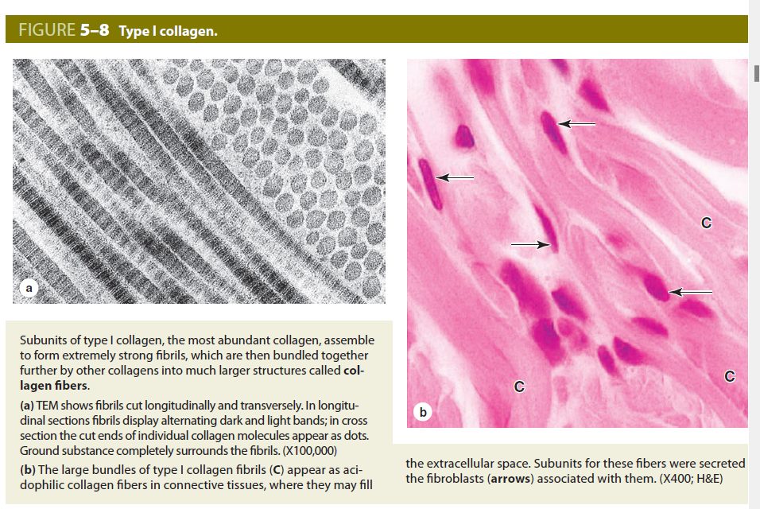

Slide 24
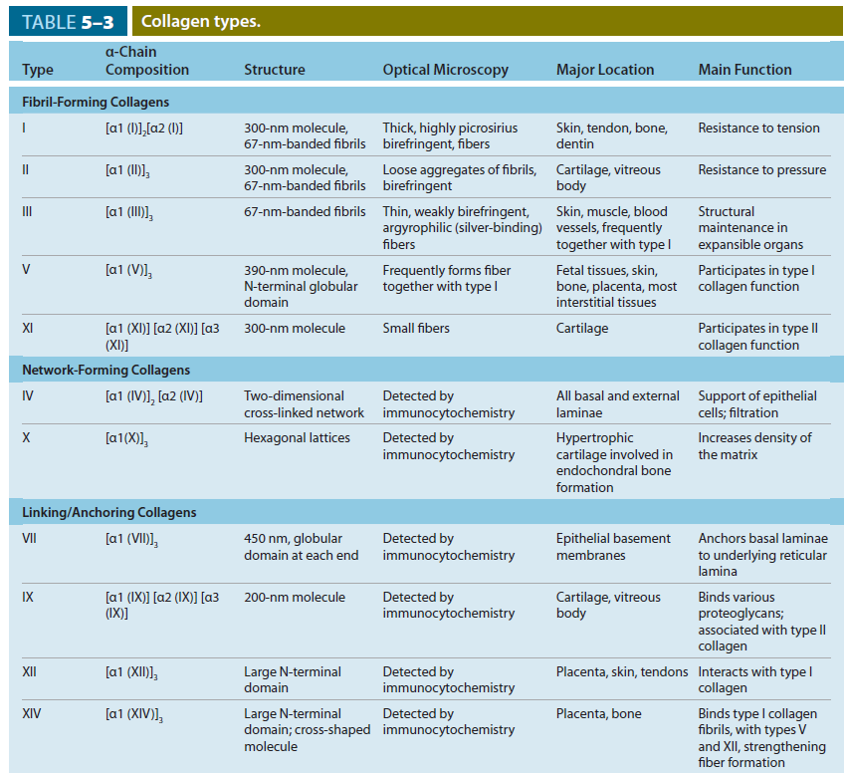

Slide 25
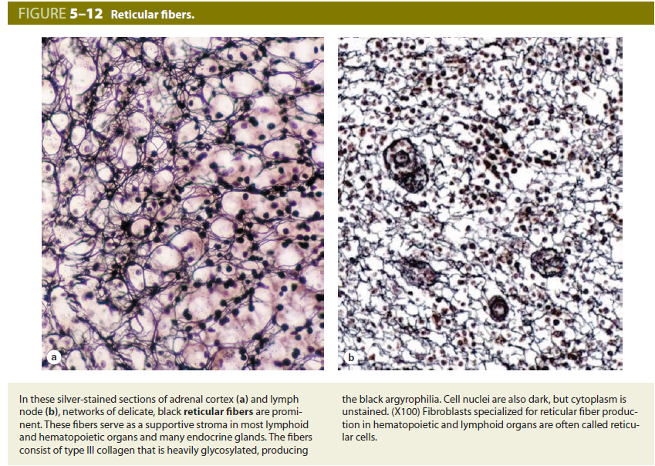
Reticular Fibers
Found in delicate connective tissue of many organs, notably in the immune system, reticular fibers consist mainly of collagen type III, which forms an extensive network (reticulum) of thin (diameter 0.5-2 μm) fibers for the support of many different cells. Reticular fibers are seldom visible in hematoxylin and eosin (H&E) preparations but are characteristically stained black after impregnation with silver salts and are thus termed argyrophilic
Reticular fibers produced by fibroblasts occur in the reticular lamina of basement membranes and typically also surround adipocytes, smooth muscle and nerve fibers, and small blood vessels. Delicate reticular networks serve as the supportive stroma for the parenchymal secretory cells and rich microvasculature of the liver and endocrine glands.

Slide 26
Elastic Fibers
Elastic fibers are also thinner than the type I collagen fibers and form sparse networks interspersed with collagen bundles in many organs, particularly those subject to regular stretching or bending. As the name implies, elastic fibers have rubberlike properties that allow tissue containing these fibers, such as the stroma of the lungs, to be stretched or distended and return to their original shape. In the wall of large blood vessels, especially arteries, elastin also occurs as fenestrated sheets called elastic lamellae. Elastic fibers and lamellae are not strongly acidophilic and stain poorly with H&E.
Elastic fibers (and lamellae) are a composite of fibrillin (350 kDa), which forms a network of microfibrils, embedded in a larger mass of cross-linked elastin (60 kDa).

Slide 27
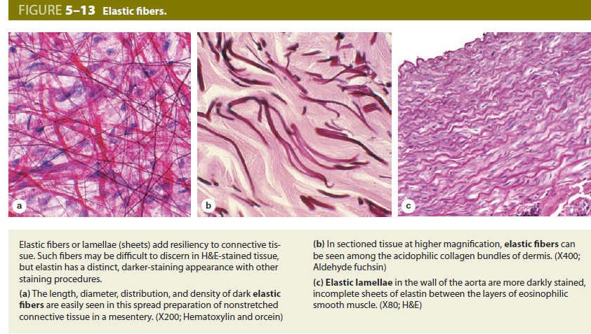

Slide 28
The ground substance
The ground substance of the ECM is a highly hydrated (with much bound water), transparent, complex mixture of three major kinds of macromolecules: glycosaminoglycans (GAGs), proteoglycans, and multiadhesive glycoproteins. Filling the space between cells and fibers in connective tissue, ground substance allows diffusion of small molecules and, because it is viscous, acts as both a lubricant and a barrier to the penetration of invaders. Physical properties of ground substance also profoundly influence various cellular activities. When adequately fixed for histologic analysis, its components aggregate as fine, poorly resolved material that appears in TEM preparations as electron-dense filaments or granules.

Slide 29
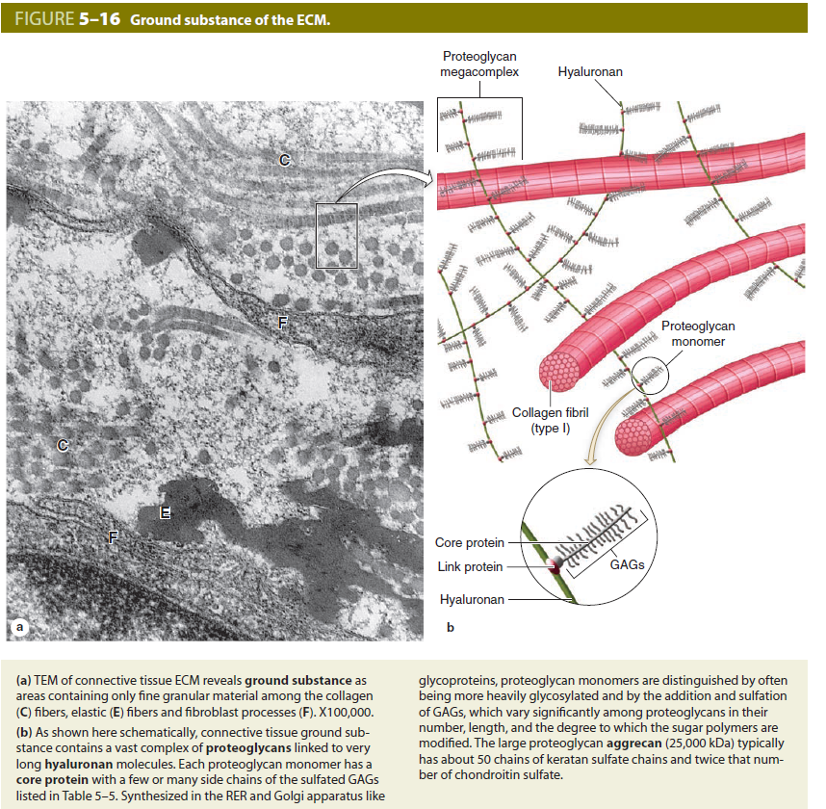

Slide 30

TYPES OF CONNECTIVE TISSUE

Slide 31
Connective Tissue Proper
Loose connective tissue
Connective tissue proper is broadly classified as “loose” or “dense,” terms that refer to the amount of collagen present.
Loose connective tissue is common, forming a layer beneath the epithelial lining of many organs and filling the spaces between fibers of muscle and nerve
Also called areolar tissue, the loose connective tissue typically contains cells, fibers, and ground substance in roughly equal parts. The most numerous cells are fibroblasts, but the other types of connective tissue cells are also normally found, along with nerves and small blood vessels. Collagen fibers predominate, but elastic and reticular fibers are also present. With at least a moderate amount of ground substance, loose connective tissue has a delicate consistency; it is flexible and not very resistant to stress.

Slide 32
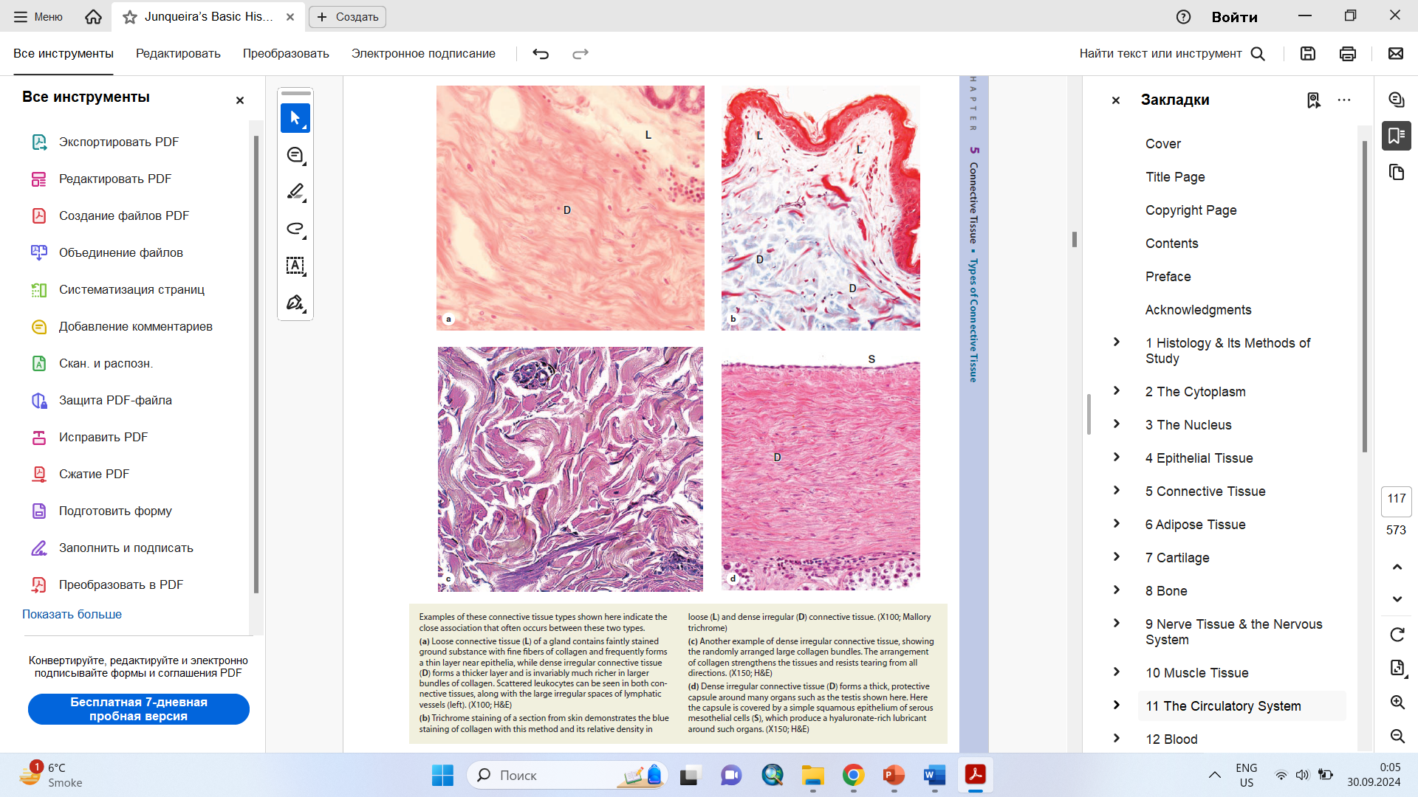

Slide 33
Dense connective tissue has similar components as loose connective tissue, but with fewer cells, mostly fibroblasts, and a clear predominance of bundled type I collagen fibers over ground substance.
In dense irregular connective tissue, bundles of collagen fibers appear randomly interwoven, with no definite orientation. Examples of dense irregular connective tissue include the deep dermis layer of skin and capsules surrounding most organs. Dense irregular and loose connective tissues are often closely associated, with the two types grading into each other and making distinctions between them somewhat arbitrary.

Slide 34
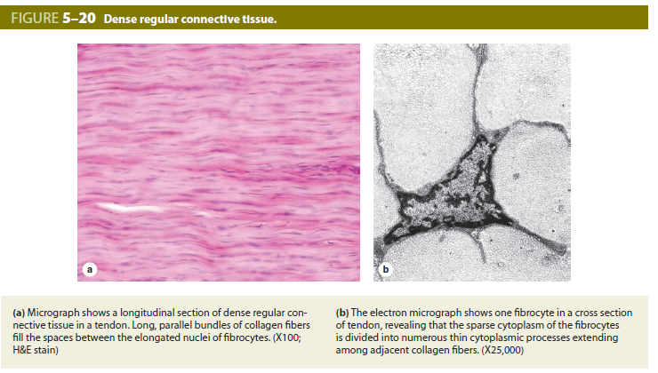
Dense regular connective tissue consists mostly of type I collagen bundles and fibroblasts aligned in parallel for great resistance to prolonged or repeated stresses from the same direction

Slide 35
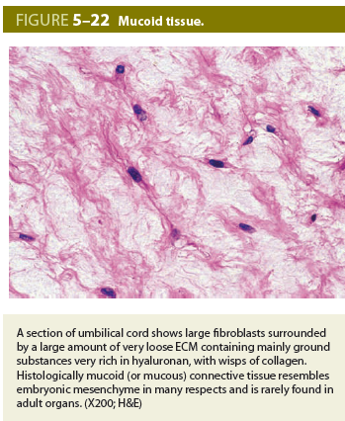
Mucoid Tissue
Embryonic Connective Tissues
Mucoid (or mucous) connective tissue is the principal component of the fetal umbilical cord, where it is referred to as Wharton’s jelly. With abundant ground substance composed chiefly of hyaluronan, mucoid tissue is gelatinous, with sparse collagen fibers and scattered fibroblasts. Included among the fibroblastic cells are many mesenchymal stem cells, which are being studied for their potential in regenerative medicine. Mucoid connective tissue is similar to the tissue found in the vitreous chambers of eyes and pulp cavities of young teeth.

Slide 36
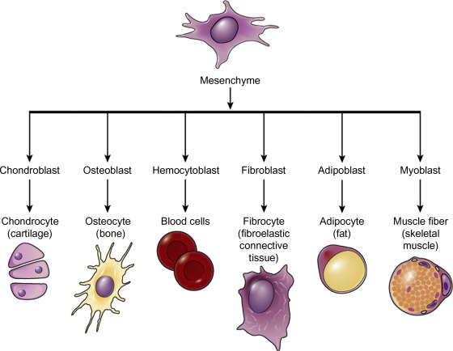
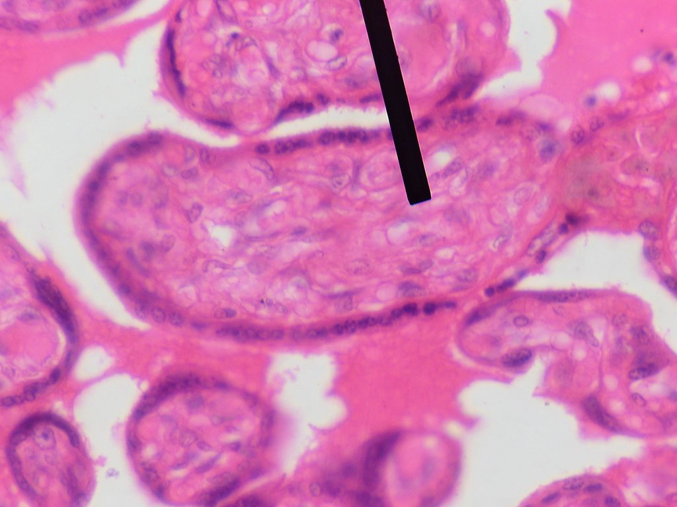
Mesenchyme
Mesenchymal cells are progenitors to a number of types of tissues, specifically cartilage, bone, connective tissue, muscle, blood, and adipose tissue.
Mesenchyme is a type of loosely organized animal embryonic connective tissue of undifferentiated cells that give rise to most tissues, such as skin, blood or bone. The interactions between mesenchyme and epithelium help to form nearly every organ in the developing embryo

Slide 37
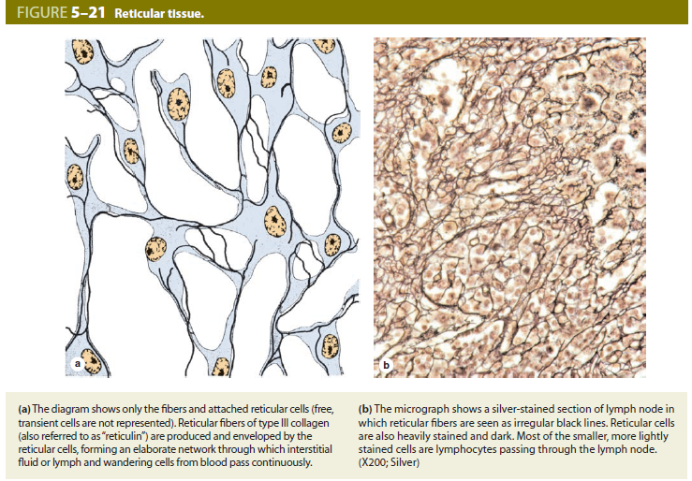
Reticular Tissue
Specialized Connective Tissues
Reticular tissue is characterized by abundant fibers of type III collagen forming a delicate network that supports various types of cells. This collagen is also known as reticulin and is produced by modified fibroblasts often called reticular

Slide 38
Adipose tissue
Connective tissue in which fat-storing cells or adipocytes predominate is called adipose tissue. These large cells are typically found isolated or in small groups within loose or dense irregular connective tissue but occur in large aggregates in adipose tissue or “fat” in many organs and body regions. Adipose tissue normally represents 15%-20% of the body weight in men, somewhat more in women. Besides serving as storage depots for neutral fats, chiefly triglycerides (long-chain fatty acyl esters of glycerol), adipocytes function as key regulators of the body’s overall energy metabolism. With a growing epidemic of obesity and its associated health problems, including diabetes and heart disease, adipocytes and adipose tissue now constitute a major area of medical research.

Slide 39
The defining cells of adipose tissue (fat), adipocytes, are very large cells derived from mesenchyme and specialized for energy storage in lipid droplet(s) with triglycerides.
■■Adipocytes store lipids from three sources: from dietary fats packaged as chylomicrons in the intestine; from triglycerides produced in the liver; and from fatty acids synthesized locally.
■■There are two types of adipose tissue: white fat and brown fat.

Slide 40
White Adipose Tissue
White adipose tissue is found in many organs throughout the body, typically forming about 20% of the body weight in adults.
Adipocytes of white fat are typically very large cells, ranging in diameter from 50 to 150 μm.
These cells each contain primarily one large lipid droplet (they are unilocular), causing the nucleus and remaining cytoplasm to be pushed against the plasmalemma.
Fatty acids are released from white adipocytes by lipase activity when nutrients are needed and carried throughout the body on plasma proteins such as albumin.
Leptin is a polypeptide hormone with target cells in the hypothalamus that is released from white adipocytes and helps regulate eating behavior.
white adipose tissue (WAT), the body’s main energy storage

Slide 41
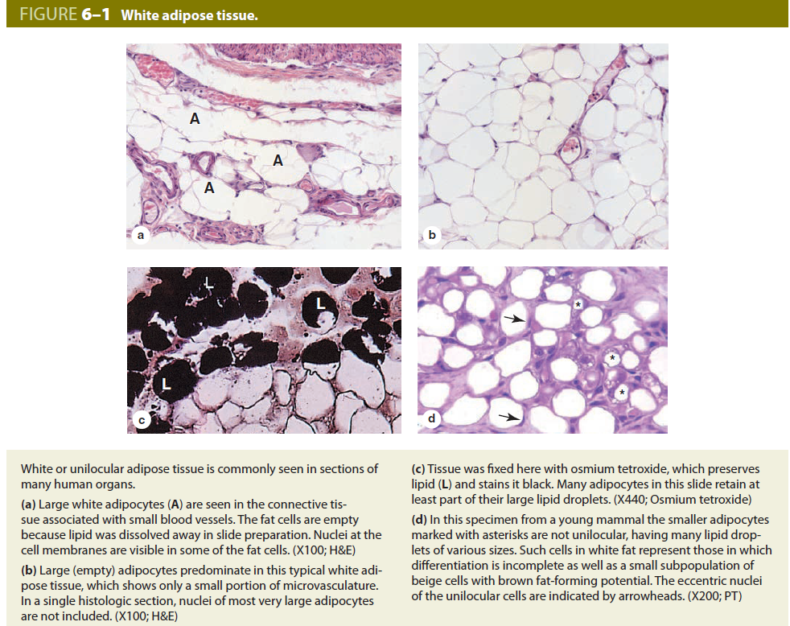

Slide 42
Brown Adipose Tissue
Brown fat comprises up to 5% of the newborn body weight but smaller amounts in adults.
Adipocytes of this tissue are typically smaller than those of white fat and contain primarily many small lipid droplets (they are multilocular) in cytoplasm containing many mitochondria and a central nucleus.
Fatty acids released in adipocytes of brown fat are metabolized in mitochondria of these cells for thermogenesis rather than ATP synthesis, using uncoupling protein-1.
brown adipose tissue (BAT) that dissipates energy as a defense against cold and maintains energy balance for the whole body

Slide 43
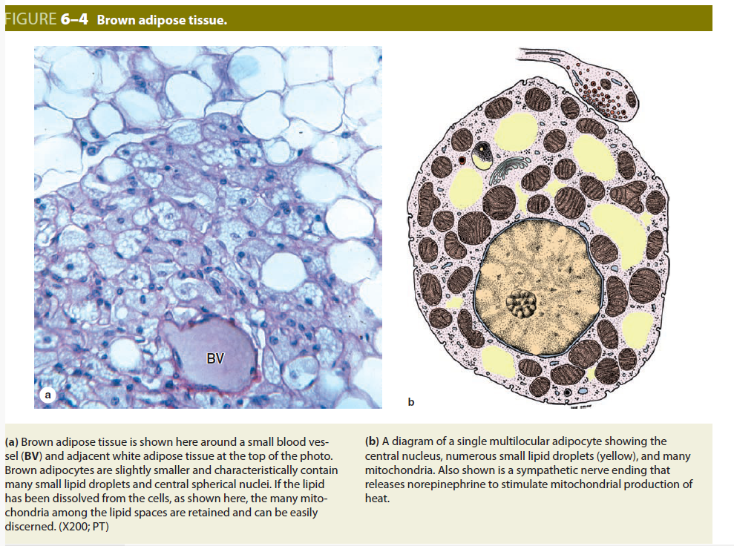

Slide 44
Blood tissue
Blood is a specialized connective tissue consisting of cells and fluid extracellular material called plasma. Propelled mainly by rhythmic contractions of the heart, about 5 L of blood in an average adult moves unidirectionally within the closed circulatory system. The so-called formed elements circulating in the plasma are erythrocytes (red blood cells), leukocytes (white blood cells [WBCs]), and platelets.

Slide 45
Composition of plasma
Plasma is an aqueous solution, pH 7.4. In the plasma the dissolved components are mostly plasma proteins, but they also include nutrients, respiratory gases, nitrogenous waste products, hormones, and inorganic ions collectively called electrolytes. The major plasma proteins include the following:
■ Albumin, the most abundant plasma protein, is made in the liver and serves primarily to maintain the osmotic pressure of the blood.
■ Globulins (α- and β-globulins), made by the liver and other cells, include transferrin and other transport fac tors; fibronectin; prothrombin and other coagulation factors; lipoproteins and other proteins entering blood from tissues.
■ Immunoglobulins (antibodies or γ-globulins) secreted by plasma cells in many locations.
■ Fibrinogen, the largest plasma protein (340 kD), also made in the liver, which, during clotting, polymerizes as insoluble, cross-linked fibers of fibrin that block blood loss from small vessels.
■ Complement proteins, which comprise a defensive system important in inflammation and destruction of microorganisms.

Slide 46
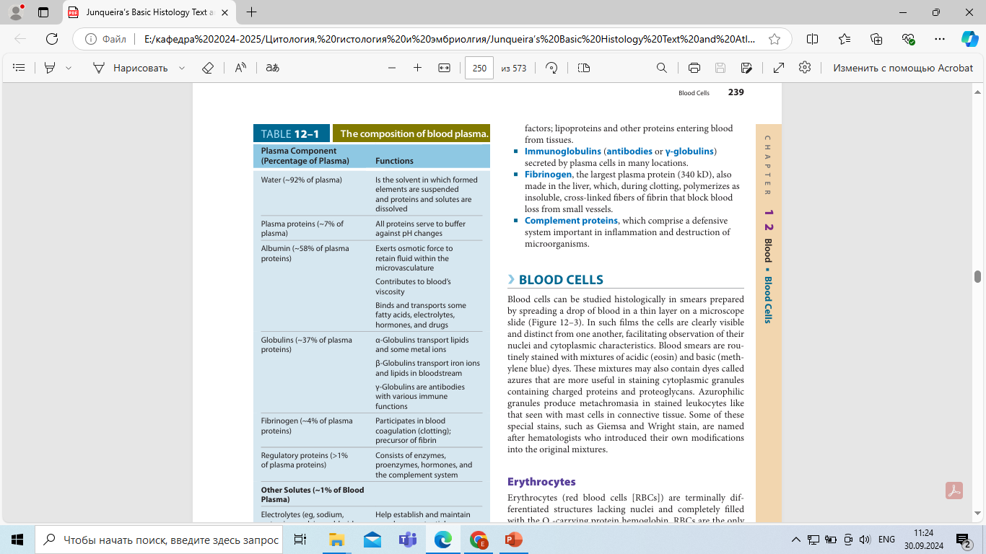
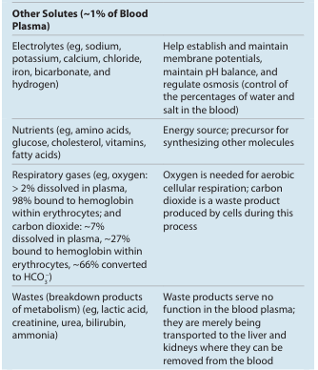

Slide 47
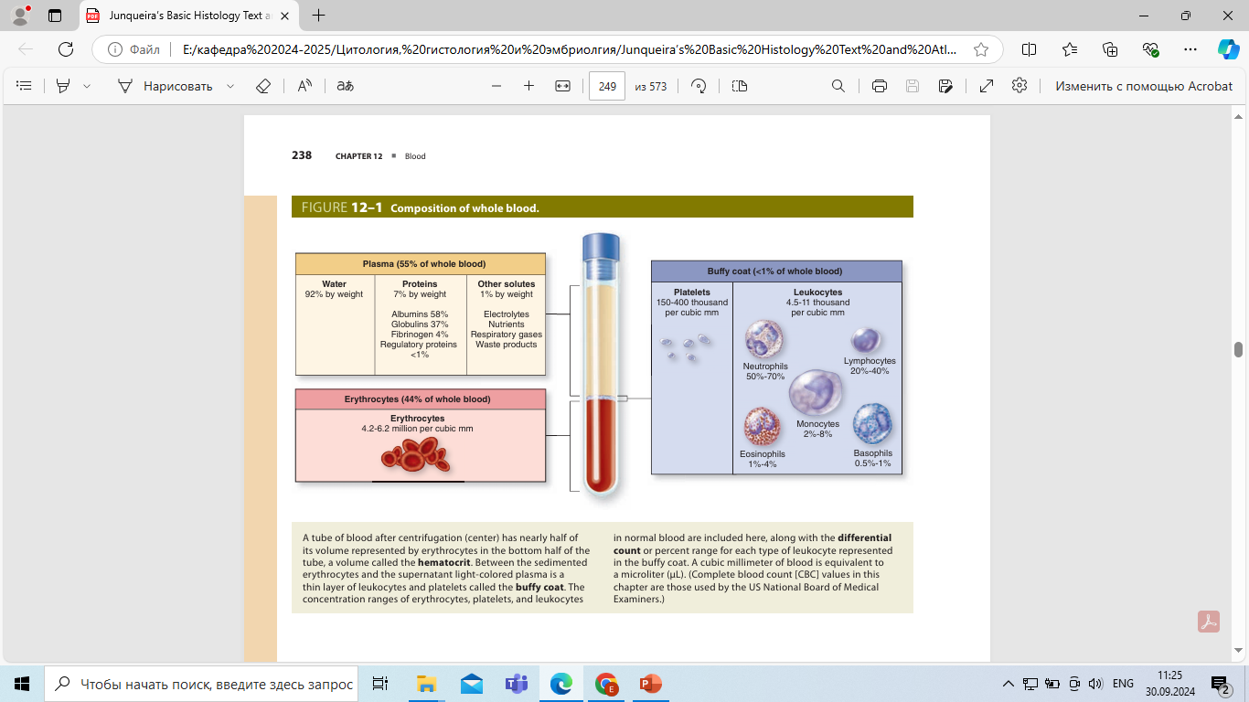
Notes:
A tube of blood after centrifugation (center) has nearly half of its volume represented by erythrocytes in the bottom half of the tube, a volume called the hematocrit. Between the sedimented erythrocytes and the supernatant light-colored plasma is a thin layer of leukocytes and platelets called the buffy coat. The concentration ranges of erythrocytes, platelets, and leukocytes in normal blood are included here, along with the differential count or percent range for each type of leukocyte represented in the buffy coat. A cubic millimeter of blood is equivalent to a microliter (μL).

Slide 48
Blood cells
RBCs or erythrocytes, which make up the hematocrit portion (~45%) of a blood sample, are enucleated, with 7.5 μm in diameter, filled with hemoglobin for the uptake, transport, and release of O2 , and with a normal life span of about 120 days. Because of their uniform dimensions and their presence in most tissue sections, RBCs can often be used by histologists as an internal standard to estimate the size of other nearby cells or structures.

Slide 49
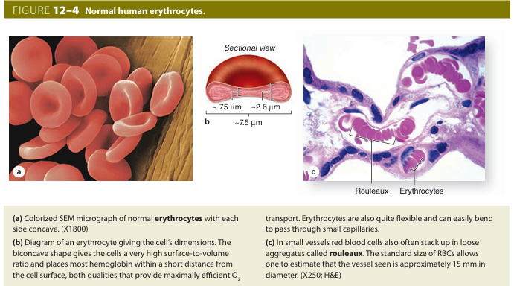

Slide 50
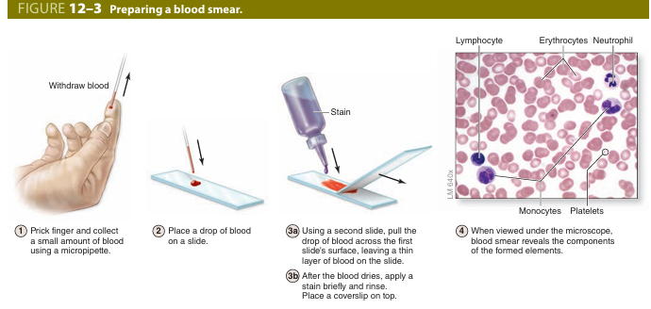

Slide 51
■WBCs or leukocytes are broadly grouped as granulocytes (neutrophils, eosinophils, basophils) or agranulocytes (lymphocytes, monocytes), based on the density of their cytoplasmic granules.
Granulocytes possess two major types of abundant cytoplasmic granules: lysosomes (often called azurophilic granules in blood cells) and specific granules that bind neutral, basic, or acidic stains and have specific functions. Granulocytes also have polymorphic nuclei with two or more distinct (almost separated) lobes and include the neutrophils, eosinophils, and basophils. All granulocytes are also terminally differentiated cells with a life span of only a few days. Their Golgi complexes and rough ER are poorly developed, and with few mitochondria they depend largely on glycolysis for their energy needs. Most granulocytes undergo apoptosis in the connective tissue and billions of neutrophils alone die each day in adults. The resulting cellular debris is removed by macrophages and, like all apoptotic cell death, does not itself elicit an inflammatory response.
Agranulocytes lack specific granules, but do contain some azurophilic granules (lysosomes). The nucleus is spherical or indented but not lobulated. This group includes the lymphocytes and monocytes.

Slide 52
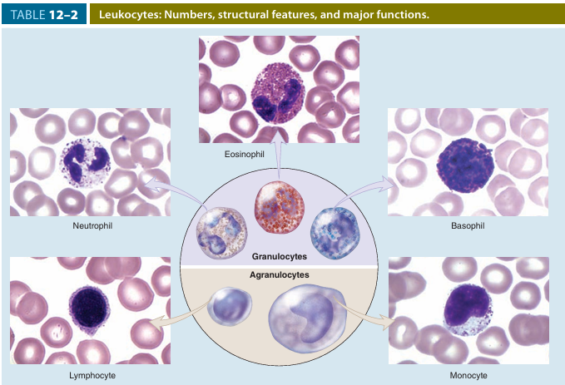

Slide 53
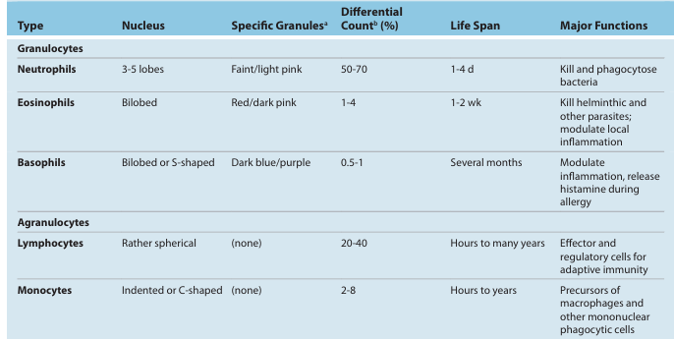

Slide 54
Neutrophils (Polymorphonuclear Leukocytes)
Mature neutrophils constitute 50%-70% of circulating leukocytes, a figure that includes slightly immature forms released to the circulation. Neutrophils are 12-15 μm in diameter in blood smears, with nuclei having two to five lobes linked by thin nuclear extensions. In females, the inactive X chromosome may appear as a drumstick-like appendage on one of the lobes of the nucleus although this characteristic is not always seen. Neutrophils are inactive and spherical while circulating but become amoeboid and highly active during diapedesis and upon adhering to ECM substrates such as collagen.

Slide 55
The cytoplasmic granules of neutrophils provide the cells’ functional activities and are of two main types.
Azurophilic primary granules or lysosomes are large, dense vesicles with a major role in both killing and degrading engulfed microorganisms.
They contain proteases and anti bacterial proteins, including the following:
■Myeloperoxidase (MPO), which generates hypochlorite and other agents toxic to bacteria
■ Lysozyme, which degrades components of bacterial cell walls
■ Defensins, small cysteine-rich proteins that bind and disrupt the cell membranes of many types of bacteria and other microorganisms.
Specific secondary granules are smaller and less dense, stain faintly pink, and have diverse functions, including secretion of various ECM-degrading enzymes such as collagenases, delivery of additional bactericidal proteins to phagolysosomes, and insertion of new cell membrane components.

Slide 56
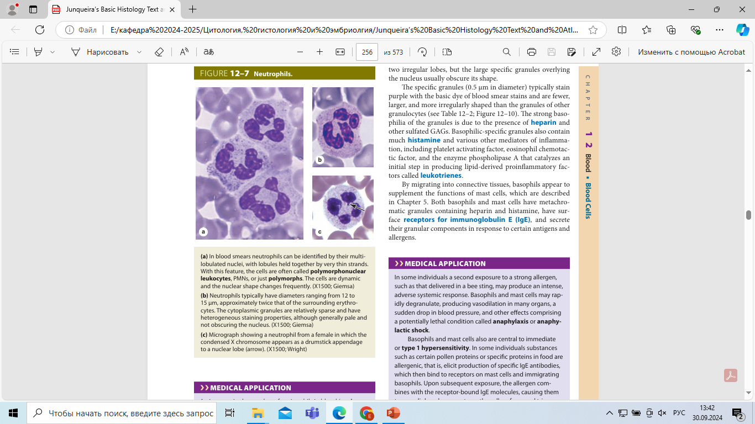

Slide 57
Eosinophils
Eosinophils are far less numerous than neutrophils, constituting only 1%-4% of leukocytes. The
main identifying characteristic is the abundance of large, acidophilic specific granules typically staining pink or red.
Ultrastructurally the eosinophilic-specific granules are seen to be oval in shape, with flattened crystalloid cores, containing major basic proteins (MBP), an arginine-rich factor that accounts for the granule’s acidophilia and constitutes up to 50% of the total granule protein. MBPs,
Eosinophils also modulate inflammatory responses by releasing chemokines, cytokines, and lipid mediators, with an important role in the inflammatory response triggered by allergies. The number of circulating eosinophils increases during helminthic infections and allergic reactions.

Slide 58
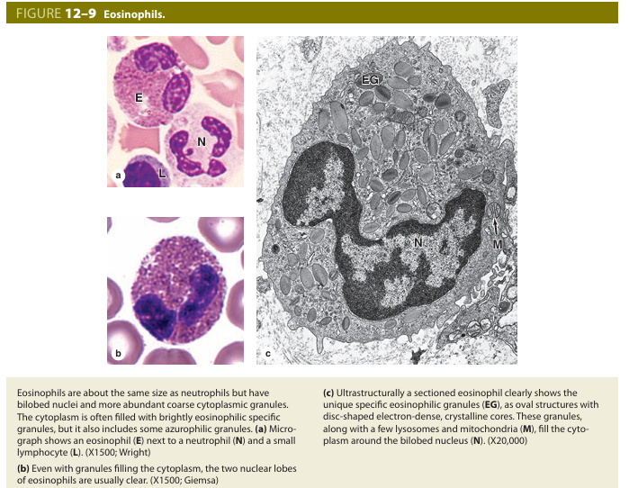

Slide 59
Basophils
Basophils are also 12-15 μm in diameter but make up less than 1% of circulating leukocytes and are therefore difficult to find in normal blood smears. The nucleus is divided into two irregular lobes, but the large specific granules overlying the nucleus usually obscure its shape.
Basophilic-specific granules also contain much histamine and various other mediators of inflammation, including platelet activating factor, eosinophil chemotactic factor, and the enzyme phospholipase A that catalyzes an initial step in producing lipid-derived proinflammatory factors called leukotrienes.
Both basophils and mast cells have metachromatic granules containing heparin and histamine, have surface receptors for immunoglobulin E (IgE), and secrete their granular components in response to certain antigens and allergens and cytotoxic T lymphocytes and natural killer (NK) cells.

Slide 60
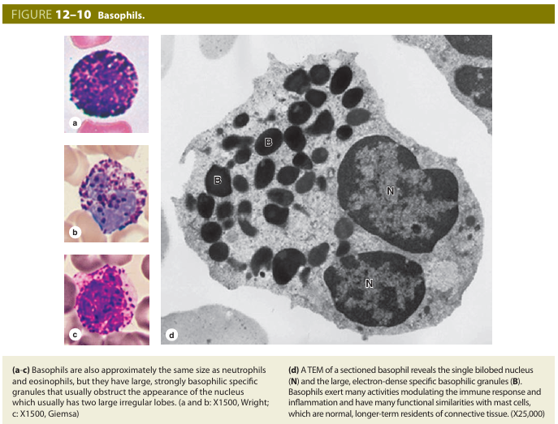

Slide 61
Platelets
Platelets are small (2-4 μm) cell fragments derived from megakary
ocytes in bone marrow, with a marginal bundle of actin filaments,
alpha granules and delta granules, and an open canalicular system
of membranous vesicles; rapid degranulation on contact with col
lagen triggers blood clotting.

Slide 62
The role of platelets in controlling blood loss (hemorrhage) and in wound healing can be summarized as follows:
Primary aggregation: Disruptions in the microvascular endothelium, which are very common, allow the platelet glycocalyx to adhere to collagen in the vascular basal lamina or wall.
Secondary aggregation: Platelets in the plug release a spe cific adhesive glycoprotein and ADP, which induce further platelet aggregation and increase the size of the platelet plug.
Blood coagulation: During platelet aggregation, fibrinogen from plasma, von Willebrand factor and other proteins released from the damaged endo thelium, and platelet factor 4 from platelet granules promote the sequential interaction (cascade) of plasma proteins, giving rise to a fibrin polymer that forms a three-dimensional network of fibers trapping RBCs and more platelets to form a blood clot, or thrombus.

Slide 63
